Slide 1
Alignment of EU-China Funding Schemes and Opportunities in the Water Sector
Business and Innovation

Slide 2
Alignment of EU-China Funding Schemes and Opportunities in the Water Sector
Presentation of the Draft Study
01
Introduction
02
Summary of Key Findings
CONTENTS
03
Next Steps

Slide 3
01 Introduction
Aim of the Study
Explore water-related issues of common interest in research and funding between Europe and China.
Contribute to the alignment of funding opportunities for business, research and innovation between Europe and China in the Water sector.
Contents of the Study
Overview of the Research Landscape in Europe and China
Overview of the Water Sector in Europe and China
Research and innovation water project trends in Europe and China
Cooperation research needs and gaps in key areas between Europe and China per research theme
Recommendations on future cooperation

Slide 4
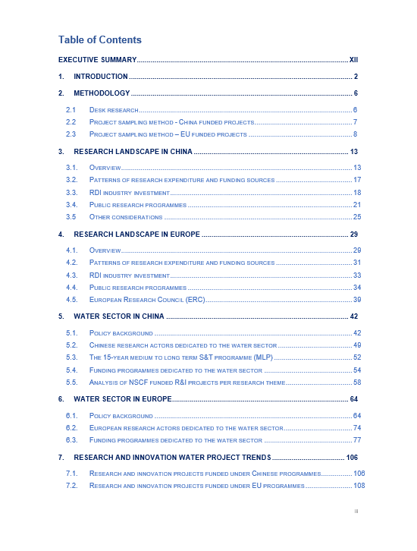
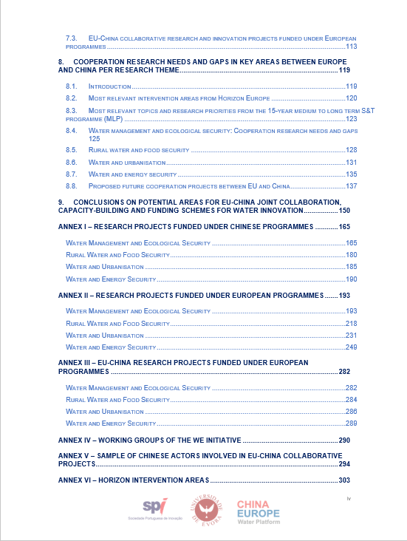
01 Introduction

Slide 5



01 Introduction
A sample of more than 250 water-related R&I projects funded under FP7, H2020, and NSFC programmes was examined and analyzed, including EU-China collaborative projects under FP7 and H2020.
Search on Chinese National Knowledge Infrastructure database, ScienceNet and CORDIS database for each of the four themes using the following key words:
  Water Management and Ecological Security: ‘Water Management Ecolog’;
  Rural Water and Food Security: ‘Rural Water Food’;
  Water and Urbanisation: ‘Water Urbanisation’;
  Water and Energy Security: ‘Water Energy’.
Methodological
Approach

Slide 6
02 Summary of Key Findings
Overall H2020 and FP7
project trends
Business
Involvement
Highest participation was observed from Business organisations (35%), followed by Research organisations (25%), Higher education establishments (24%) and Public organisations (8%).
For projects funded under FP7 programme, the total share of Business participation represents 39%, while for projects funded under H2020 is 32%.
Business members are coordinators in 25% of projects within the total sample.
The most frequent topic (from 108) was H2020-SME Support Instrument (10 projects)- SMEInst-2018-2020-1
In the past 10 years, the water R&I was mostly funded by the following programmes:
H2020 –societal Challenge/Climate Env, Resource Efficiency and Raw Materials 23% - 38 projects)
FP7 – Environment Cooperation – 20% - 30 projects
2020 Industry leadership – Leadership in enabling and industrial technologies (12% - 18 projects)
Figure 2: FP7 and H2020 participations

Slide 7
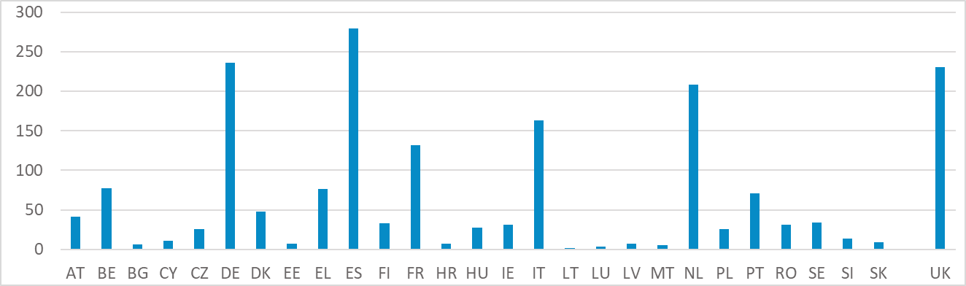
02 Summary of Key Findings
Overall H2020 and FP7
project trends
Business
Involvement
Organisations from all 27 Member States have been involved in projects, with the highest number of organisations from Spain, Germany and Netherlands (Figure 2).
Participation of business members from EU-27 and UK represents 91% of total business members identified in the sample. The remaining 9% are business from outside Europe countries.
Figure 3: Participation of organisations from EU-27

Slide 8
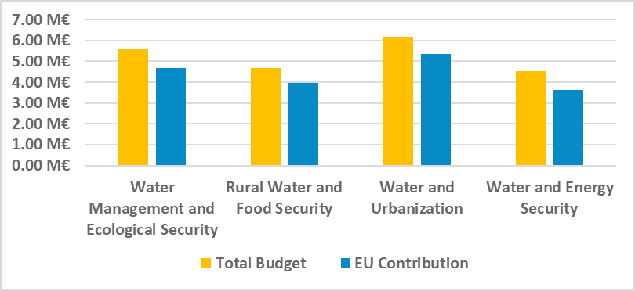
02 Summary of Key Findings
Average EU contribution per project was 84% of the total budget.
The average duration of the project was 39 months.
Budget value of the projects funded under H2020 was 25% higher compared to the projects funded under FP7.
Overall H2020 and FP7
project trends
From the identified H2020 and FP7 projects, the highest project average funding was related to the Water and Urbanization and the Water Management and Ecological Security research themes (Figure 1).
Figure 1: Average EU project value per focus area

Slide 9
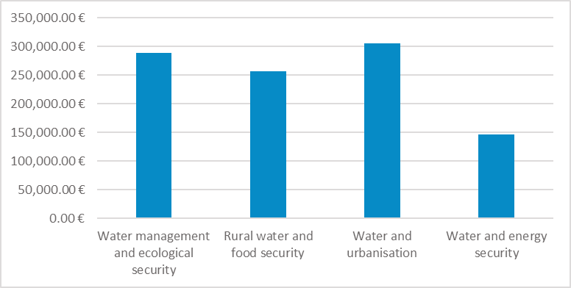
02 Summary of Key Findings
Overall NSFC project trends
The average budget allocated for each organisation was EUR 278,275.
In total, the identified projects were implemented by 47 research organisations, of which 24 organisations (51%), implemented more than one project.
From the identified NSFC projects, the highest project average funding was related to the Water and Urbanization and the Water Management and Ecological Security research themes (Figure 4).
Figure 4: Average NSFC project value per focus area

Slide 10
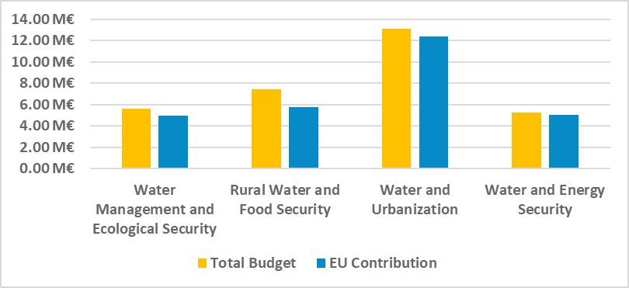
02 Summary of Key Findings
EU-China collaborative
project trends
Average EU contribution was 90% of the total budget*.
The average project duration was 52 months, with the longest project having a duration of 60 months and the shortest project having a duration of 36 months.
In the projects where Chinese participants were involved, the highest project average funding was related to the Water and Urbanization and the Rural Water and Food Security research themes (Figure 6).
Figure 6: Average EU-China collaborative project value per focus area

Slide 11
02 Summary of Key Findings
On average, two Chinese partners were involved in one EU-China collaborative project.
Organisations from 22 EU-27 Member States have been involved in the identified projects, with the highest number of organisations from Spain, Italy and Netherlands (Figure 7).
The highest number of organisations from China participated in projects related to Water Management and Ecological Security research theme.
EU-China collaborative
project trends
Figure 7: Participation in the EU-China collaborative projects per country

Slide 12
02 Summary of Key Findings
Participation of business members from EU-27 and UK represents 80% of total industry members identified in the sample
Business organisations from 15 EU-27 countries participated in the identified sample of EU-China collaborative projects, with the highest participation is observed from organisations from Spain, Netherlands and Italy (Figure 10)
EU-China collaborative
project trends
Business
Involvement
Figure 10: Participation in the EU-China collaborative projects per country

Slide 13
02 Summary of Key Findings
Overall outcomes of the Study
Common areas of interest between EU and China with links to key policy objectives and priorities of:
  a) The 15-year medium to long term S&T programme
  b) EU Green Deal Policy Areas
  c) Horizon Europe Clusters and Intervention Areas and
  d) EU-China Strategic Outlook priorities.
Relevant funding schemes in the context of Horizon Europe and the upcoming 14th FYP.
Good practice examples of the EU-China collaboration.
Important trends and considerations regarding EU and Chinese funded water R&I projects.
Cooperation research needs and gaps in key areas between Europe and China per research theme.

Slide 14
02 Summary of Key Findings
Main conclusion
The collaboration between Business and Academia leads to*:
  Integration of European research
  More cross-border and cross-sector/interdisciplinary collaboration
  Creation of a powerful framework for academic and industrial research
  De-risking effect and encouragement of entrepreneurship
  Better use of the available funding; better availability of research results
  Quicker adoption of standards
  Building of a genuinely EU-level supply chain capability
  Resolving structural issues within sectors.
* https://ec.europa.eu/programmes/horizon2020/en/partnerships-industry

Slide 15

03 Next Steps
Partnerships Water4All
Missions
General WP
Horizon
Europe
International cooperation
Excellence
Innovative
EIC
Based on the outputs from round table discussions, further recommendations for the alignment of EU-China funding programmes will be developed.
Key outcomes of the round table discussion will be presented during the round table joint session scheduled for the 21st of April.
Major S&T Projects (Mega Projects)
National Natural Science Fund
Chinese FP
China’s National Key R&D Programmes
Technology Innovation Guidance Fund
International Cooperation
Bases and Talents Programme

Slide 16
03 Next Steps

Slide 17

03 Next Steps
In the Work Programme of Horizon Europe for 2021-2022, opportunities for Business funding exist under Pillar III, particularly under, Innovative Europe.
It funds:
  breakthrough innovation with scale-up potential at the global level.
  breakthrough, deeptech and disruptive innovation, targeting especially market-creating innovation.
Application
https://eic.ec.europa.eu/index_en

Slide 18
03 Next Steps
https://ec.europa.eu/info/sites/info/files/research_and_innovation/funding/presentations/ec_rtd_he-investing-to-shape-our-future.pdf

Slide 19
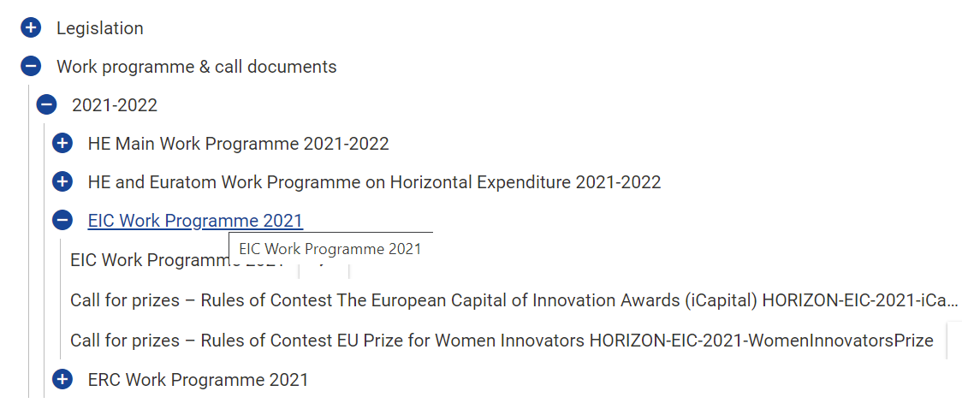
03 Next Steps
Application
https://ec.europa.eu/info/funding-tenders/opportunities/portal/screen/how-to-participate/reference-documents;programCode=HORIZON

Slide 20
03 Next Steps
Application

Slide 21

Thank you!
www.spieurope.eu
Dr. Sara Medina – Member of Board of SPI
saramedina@spi.pt
WeChat ID: tennis18sara
Dr. Ana Mendes – University of Evora
aimendes@uevora.pt
Richard Deng – Chief Representative of SPI China
richarddeng@spi-china.cn
WeChat ID: letswine
Igor Kosic – International Consultant
igorkosic@spi.pt
Johnny Pan – International Consultant
johnnypan@spi-china.cn
WeChat ID:johnnypan119
Xinting Shao – International Consultant
xintingshao@spi-china.cn
WeChat ID: xintingshao
Twitter @ChinaEUwater
#CEWP www.cewp.eu cewp.mwr.gov.cn
This action is co-funded by the European Union and P.R. China. The project partners are solely responsible for the contents, which do not necessarily reflect the views of the funding parties.

